Slide 1
Emergency Animal and Pet Care
ConEds 2017

Slide 2
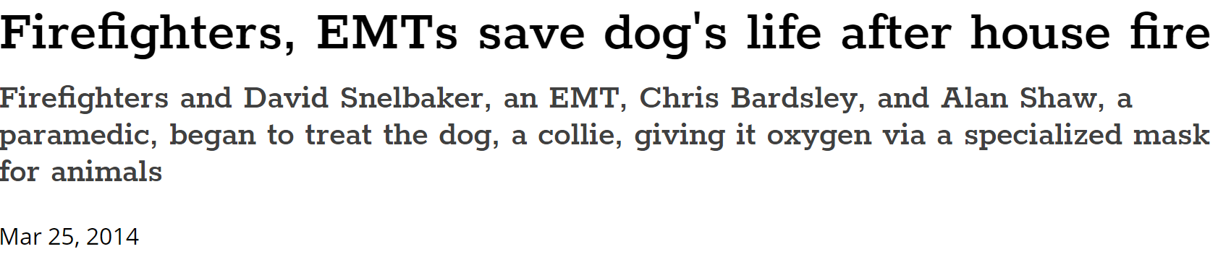



Slide 3
Background
In humans, unintentional injuries are one of the leading causes of death in ages 1-44. Similarly, traumatic injuries to animals are a leading cause of death in animals of all ages.
The origins of prehospital emergency veterinary care began with the implementation of Tactical Emergency Casualty Care (TECC) for K9s used in battlefield and police environments.
There is now a committee called K9-TECC that has established guidelines for K9 casualty care.
The American College of Veterinary Emergency and Critical Care Veterinary Committee on Trauma has established best practice guidelines for prehospital emergency veterinary care

Slide 4
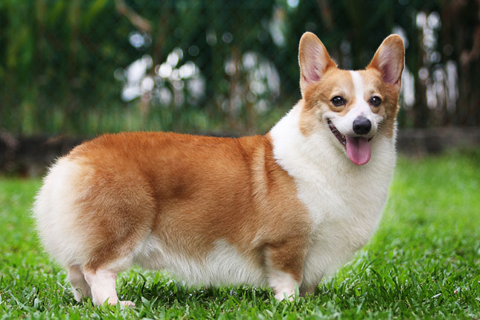




DOGGOS

Slide 5
Legal Standing
Currently, only Colorado and Ohio have adopted statewide legislation authorizing EMS providers to preform emergency veterinary care
Emergency veterinary care may not be covered by good Samaritan laws – this is essentially an untested legal field
If you decide to render care to an animal, do so within these guidelines and if possible contact medical direction

Slide 6
General Approach to Prehospital Care
Scene size-up
Patient assessment
Primary assessment
Vital parameters
Secondary (“Head-to-Tail”) assessment
Complete history
On-scene medical care
Packaging, transport, and care en-route
Reassessment
Communication and documentation

Slide 7
Scene Size Up
The same rules apply as with humans- do not approach an unsafe scene
TAKE BSI – zoonosis is rare but still possible
Number of patients
Need for additional resources
Determine MOI/NOI
Especially consider toxic hazards to the animal

Slide 8
Primary Assessment
Form a general impression- age, anxiety level, and body positioning
Anxiety is an important “vital sign” in animals
AVPU
Address life threats based on the MOI/NOI
In the following situations, expedite transport: penetrating injuries above the knees or elbows, chest wall instability, two or more proximal long bone fractures, crushed, degloved, or mangled extremity, amputation proximal to the carpals or tarsals, pelvic fracture, open or depressed skull fracture, fall from 2-3 times height, MVC with intrusion >12 inches
ABCD

Slide 9
A
The airway is patent in a barking or meowing animal, animal alert and breathing comfortably, panting but not in respiratory distress
Unconscious animals – extend the head and neck into an in-line position, manually open the mouth (try to avoid putting your fingers in the mouth), grasp the tongue and extend it out over the bottom jaw, remove and visible foreign objects (DO NOT DO A BLIND FINGER SWEEP

Slide 10
B
Look, listen, and feel for breathing
Normal respiratory rate for both cats and dogs is between 6-30 breaths/min

Slide 11
C
Assess for external hemorrhage
Palpate a femoral pulse
A normal rate is
Dog: <20 kg 100-160 bpm, 20-40 kg 60-120 bpm, >40 kg 50-80 bom
Cat: 180-240 bpm
Warm the patient

Slide 12
Spinal Protection
Spinal protection should be implemented in the following scenarios
Fall associated with loss of consciousness or altered mental status
Falls from height in which the animal has fallen on their head or back
Falls from 2-3 time their height or 15 feet
High velocity impacts
Distracting injuries (tail pull injury in cats)
Implement spinal precautions if the following signs and symptoms are present
Obvious injury to the back
Pain/tenderness to palpation of the midline spine
Weakness or paralysis
Lack of recognition of stimulus in limbs
Loss of control of bladder

Slide 13
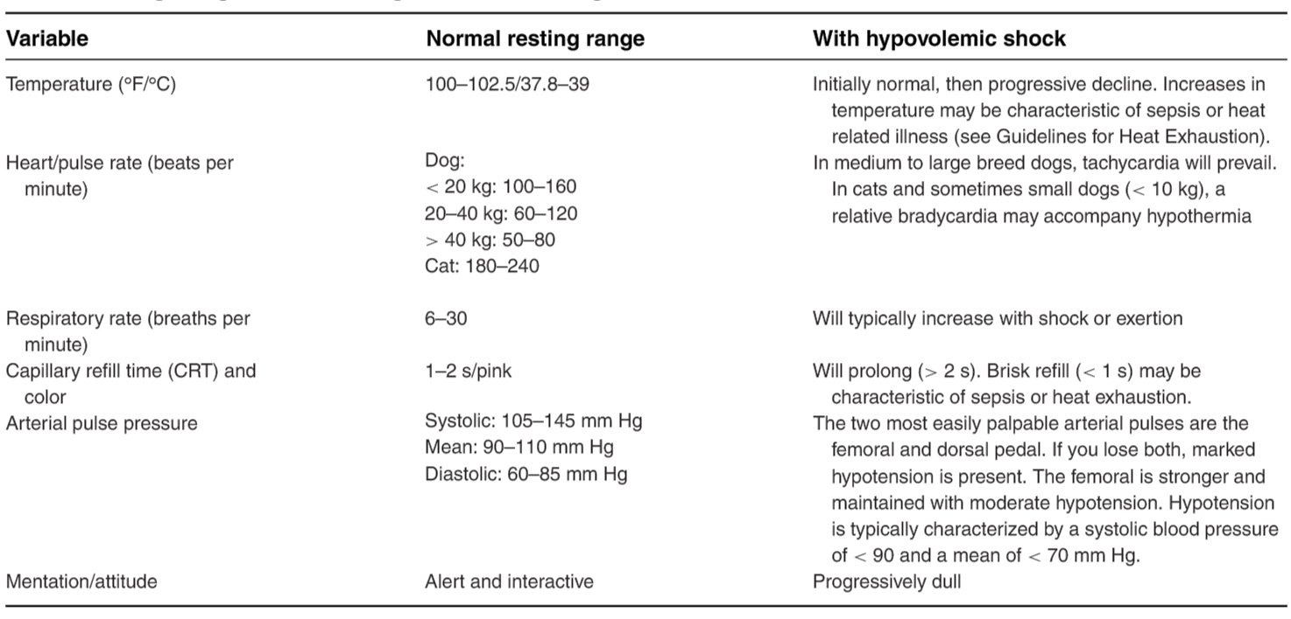
Vitals
Place a BP cuff between the elbow and wrist on the forelimb, knee and ankle on hind limb, or most proximal tail if necessary.

Slide 14
Secondary Assessment
Literally just a head to tail physical – exactly like you would do in a human
Don’t forget to
Check pupils
Auscultate lung sounds
Palpate the abdomen
Assess all four extremities

Slide 15
History
If possible, ascertain a SAMPLE history from the animal’s handler/owner
OPQRST can be used on animals!
How do you rate the severity of the pain? You judge it similar to the FACES scale – again ask someone familiar with the animal, they will know best

Slide 16




CATS

Slide 17
Specific Emergencies

Slide 18
External Hemorrhage
Immediately apply firm direct pressure with a gloved hand, followed by gauze (if available with hemostatic agent), and finally with pressure dressing
Consider occlusive dressings for wounds to head and neck
If your pressure dressing becomes soaked through, do not remove the original dressing, add more dressing
If a limb is involved, elevate the limb
If bleeding is not controlled consider a tourniquet
Most human tourniquets will not work on most animals. The ideal tourniquet is a pediatric blood pressure cuff or improvised cloth/cravat tourniquet
Keep the patient warm and provide supplemental oxygen
Medics may provide fluid resuscitation and anti-fibrinolytic agents

Slide 19
Respiratory Distress
Place the animal on it’s belly, upright
In animals, work of breathing generates lots of heat. If necessary, consider cooling if temperature exceeds 105 F
Always administer oxygen. Flow-by oxygen can be accomplished by
Placing simple oxygen tubing 2 cm from the nostril – at 2-3 Lpm, FiO2 is 25-40%. Flow may be increased to 8-10 Lpm but may not be tolerated well.
Place the most appropriately sized nonrebreather, remove one or both diaphragms if possible to prevent CO2 buildup. Flow of 8-12 Lpm can provide FiO2 of 50-60%
BVMs may be used in animals

Slide 20
Respiratory Distress
Signs of a foreign object include pawing at the mouth, gagging, excessive drooling, frequent swallowing, and extended head and neck. Importantly, stridor is heard.
If a complete airway obstruction is present, perform the Heimlich maneuver – place the animal on its side and apply a thrusting force to the ribs, this works for most animals. For dogs only, you may place the dog upright and attempt abdominal thrusts below the sternum.
If not breathing, provide mouth to snout rescue breaths at 10 breaths per minute
Dogs- close the mouth and place your mouth over the nose.
Cats- Place your mouth over both the mouth and nose.

Slide 21
Respiratory Distress
Auscultate the lungs
If crackles are heard, consider contusions, pneumothorax, non cardiogenic or cardiogenic edema. Provide oxygen.
If expiratory wheeze is heard, in dogs consider toxic inhalants – dogs rarely get asthma. Asthma is possible in cats, for a wheeze consider administration of 1-2 puffs of albuterol MDI every 15 minutes for a maximum 3 doses.
Decreased lung sounds, consider pneumothorax or hemothorax and evaluate for tension pneumothorax
Medics may attempt needle thoracentesis if orthopnea is noted, inserting the needle between the 7th and 9th ribs (to palpate the ribs, it is easiest to count backwards from the 13th rib)

Slide 22
Cardiac Arrest
If animal is unresponsive, check for respirations, if respirations are not present position airway, check pulse.
Perform chest compressions – place the animal on their side on a hard surface. Compress the ribs at a rate of 100-120 compressions per minute to between 1/3 and ½ the chest depth.
In large animals, perform CPR as in humans with the hand over hand technique
In smaller animals, consider an infant approach with a one handed squeezing motion of the ribs or two hands encircling, compressing with thumbs
Compressions should be over the heart – landmark for the heart is at the point of the elbow when the limb is flexed
For a single rescuer, perform 30 compressions to 2 breaths
For two rescuers, rotate compressors every two minutes and provide ventilations at a rate of 10 breaths per minute while compressions are ongoing

Slide 23
ALS Cardiac Arrest
Medics may place an ETT tube (RSI is achieved with ketamine and diazepam or midazolam)
Medics may establish IV access with lactated Ringer’s
Place an ECG by placing ECG pads on animals foot pads. Broadly, the same criteria as humans may be applied to determine shockable vs. nonshockable rhythm.
For a shockable rhythm in small dogs and cats, administer 30J, medium dogs administer 60 J, for large dogs administer 100J
Place defibrillator paddles overlying the heart on opposite sides of the chest
An AED may be used on large dogs (>30 kg). Fur will have to be removed from the animal. Take care to avoid pads are well spaced.
https://youtu.be/kaBNhX7dj_w

Slide 24
Analgesia
Never give any oral pain medications
Animals will tolerate a variety of IV pain medications including ketamine, fentanyl, tramadol etc.

Slide 25
Head and Spinal Trauma
If indicated, place the animal on a rigid board (backboard) and secure by placing straps or tape. To move the animal onto the backboard, scruff the animal behind the neck and near the rump.
To protect the c-spine, place padding under the animals neck such that it is in a neutral inline position – avoid hyperextension.

Slide 26
Penetrating Trauma
Place in position of comfort
Provide oxygen
Immediately cover open or sucking chest wounds with a gloved hand. If available, place a commercial chest seal such as a tegaderm. Otherwise place an occlusive dressing taped on all 4 sides.
Fur poses a problem – if it can be quickly removed, do so. If it cannot, consider placing a water based lubricant on the underside of the seal to provide a more airtight seal.
Monitor for tension pneumothorax. If signs of tension PTX develop, burp the chest seal.
Do not remove impaled objects
For evisceration, wash gross contamination with crystalloid solution or sterile water, cover with moistened sterile gauze, cover to keep warm.

Slide 27
Fracture/Dislocation
Transfer patient to rigid board for transport to minimize movement
If transport times are less than 20 minutes, it may be best to avoid splinting
Clean large wounds or open fractures
If distal limb pulses are absent, attempt to realign to a neutral position. Do not use excessive force and stop if significant resistance is met. Splint in position found.
If unsure of pulse (most likely) splint in position found
Splinting of fracture is best accomplished with SAMM splint

Slide 28
Gastric Dilation with Volvulus
This is a life threatening condition specific to dogs known as “bloat,” where the stomach rotates and causes gas and fluid buildup which results in increased pressure that decreases venous return to the heart and global hypoxia.
Look for distention of the abdomen especially outward (left-right) distention, general discomfort and agitation, retching and attempting to vomit with no vomitus, tachycardia, decreased femoral pulses, pale mucous membranes, rapid breathing
Transport rapidly
Needle gastric decompression (trocarization) may be attempted.
Percuss the abdomen while listening with stethoscope. Choose the location just behind the ribs that is most hyper-resonant. Remove fur and clean area with skin disinfectant. Place large bore (14-16 Ga) over needle catheter (or 18 Ga needle if catheter not available) perpendicular to the body wall at the chosen site. Remove the catheter when abdomen is decompressed.

Slide 29
Heat Emergency
Recognize the following behaviors of heat emergency – shade seeking, flattening of tongue or dangling of tongue, less direct return to handler, squinty eyes, excessive panting (retractions at corners of mouth, “smiling”)
If rectal temperature is available and above 106 F take cooling measures, otherwise utilize clinical judgement
Immerse young healthy patients in cool water, do not immerse the head
Dousing with water if immersion is not possible is also appropriate
Older animals with comorbidities may have cold packs places in axilla and groin, spray skin with room temperature water and fan
If shivering occurs, vigorously rub the animal or slightly warm until shivering stops
If seizure occurs, consider hypoglycemia and give corn syrup

Slide 30
Burns
Cool wound with copious amounts of tepid water
Remove any items that may cause constriction such as leashes, “clothes” etc
Apply dry, nonadherent sterile dressing
Elevate burned extremities
Protect from hypothermia – burns over 20% of BSA easily will result in hypothermia
BSA
Each rear limb is 18%
Each forelimb is 9%
Each hemithorax is 9%
Each hemiabdomen is 9%
The head is 9%
The neck is 1%

Slide 31
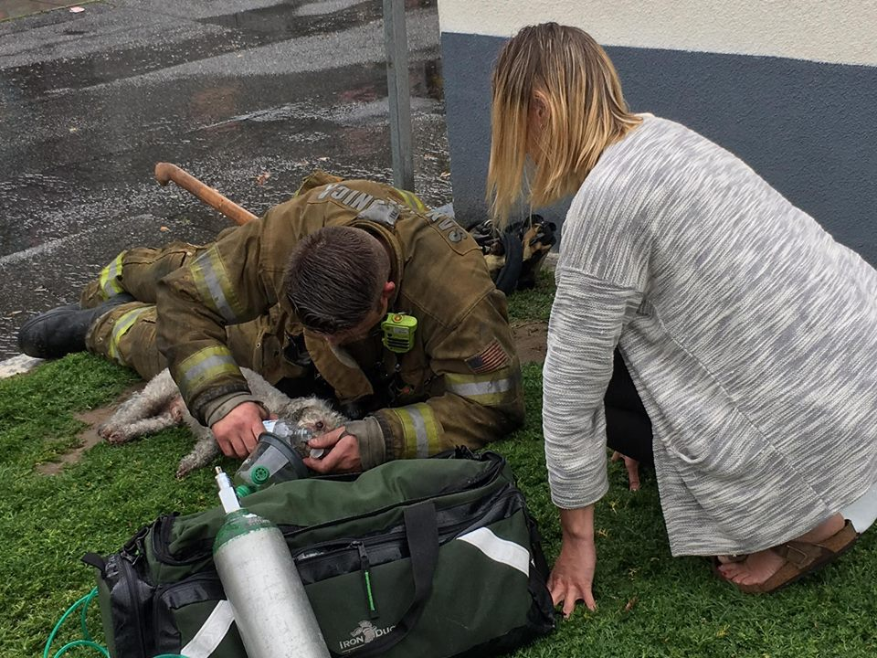
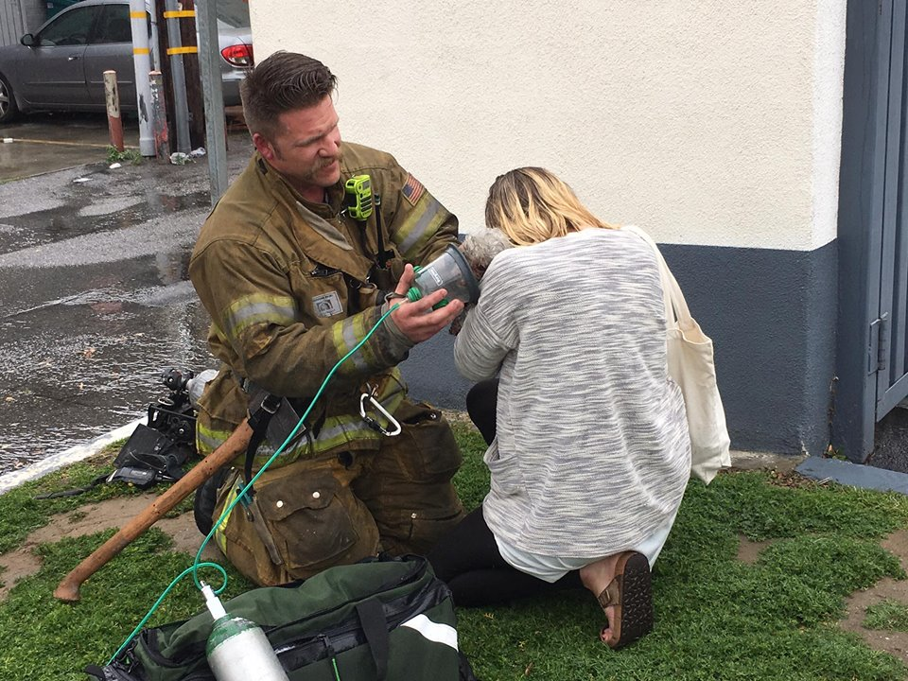
Smoke Inhalation
Very common
Administer oxygen!
Up to 100% FiO2 can be administered but pulse oximetry should be utilized if possible, titrate to above 94%
If wheezing or stridor is heard, consider administration of albuterol MDI
https://social.newsinc.com/media/json/69017/27676711/singleVideoOG.html?type=VideoPlayer/Single&widgetId=2&trackingGroup=69017&videoId=27676711

Slide 33
Anaphylaxis
In dogs, cutaneous signs such as erythema, urticarial, pruritus, angioedema likely present with cardiovascular, gastrointestinal, and respiratory signs including tachycardia, weak pulses, change in color of mucous membranes, urinating, vomiting, hemorrhagic diarrhea, increased respiratory effort, wheezes and crackles.
Cats most often present with GI symptoms including nausea, diarrhea and may also present with head pruritus, followed by dyspnea, salivation, vomiting, incoordination, and collapse.
For respiratory, CV, and GI symptoms, administer epinephrine. Administer .15 mg epinephrine (EpiPen Jr) in patients <20 kg, administer .3 mg epinephrine (EpiPen) in patients > 20 kg. Repeat dosing every 5-15 minutes if anaphylaxis persists.
For respiratory symptoms, also administer albuterol MDI.

Slide 34
Poisoning
Provide supportive care
Contact ASPCA Animal Poison Control Center at (888) 426-4435 and follow their directions
Activated charcoal may be administered at 1-4 g/kg with consultation from poison control

Slide 35






AMINALS

Slide 36
More Information
For complete guidelines, see Best practice recommendations for prehospital veterinary care of dogs and cats, Journal of Veterinary Emergency and Critical Care 26(2) 2016, pp 166–233 doi: 10.1111/vec.12455
http://time.com/4712367/santa-monica-firefighter-dog-cpr/?xid=time_socialflow_facebook
http://prehospitalwisdom.blogspot.com/2016/08/dogs-part-1-hurt-dogs.html
http://www.k9tecc.org/

